Slide 1
Learn ReactJS and Become a Frontend Developer

Slide 2
Agenda
What is Frontend development
Roadmap & some number facts
Introduction to React
Understanding Core React fundamentals
Components & JSX
Real DOM & Virtual DOM
Reconciliation
React States and React Hooks
Getting Started and understanding useState with Examples.
Project 1 - Building Todo list React App
Project 2 - Building Airline Landing Page

Slide 3


Slide 4
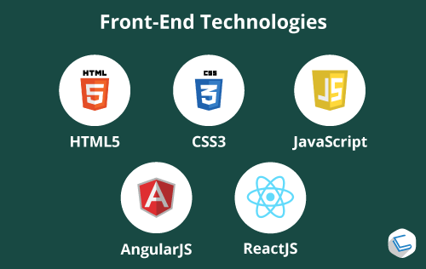

Slide 5
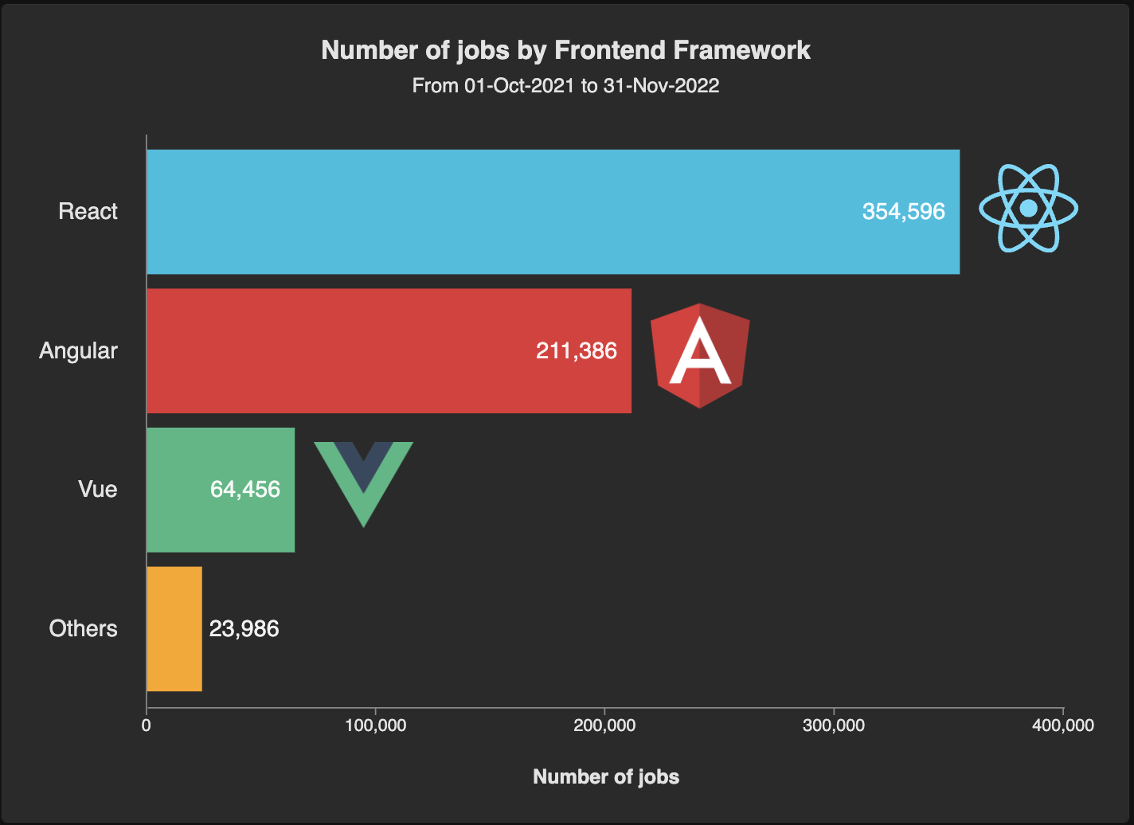
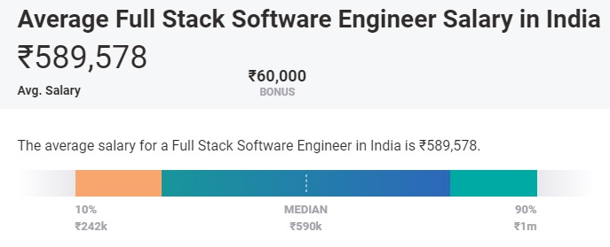
Some Number Facts

Slide 7
Introduction & What is React
React Js is front-end library developed by Facebook. It is used for building the view layer or UI layer for web and mobile apps.
It’s currently one of the most popular javascript libraries and has a strong & large dev community.
Beauty of React is to break complex UIs into small isolated pieces of code called components
React Js allows us to create reusable UI components.

Slide 8
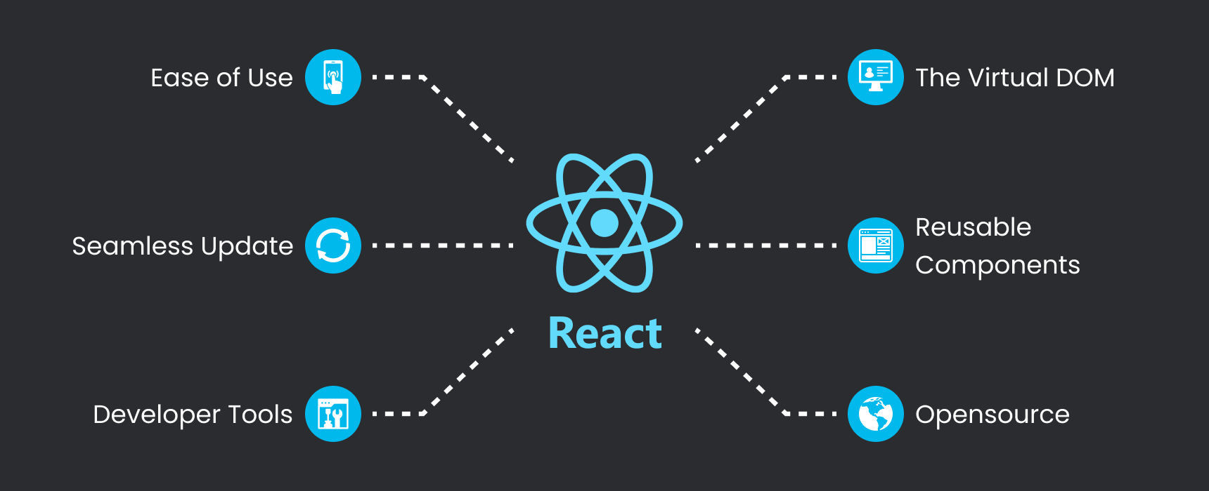

Slide 9
Understanding Core React

Slide 10
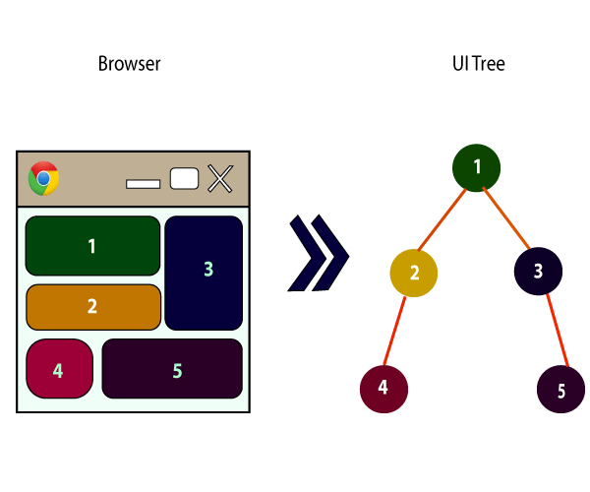
1. Components
React is all about components. You need to think of everything as a component.
A component is a small, reusable piece of code that represents a part of a user interface.
This is help you maintain the code when working on larger projects.
Components can be defined as either a class or a function and can include a combination of HTML, CSS, and JavaScript code.

Slide 11
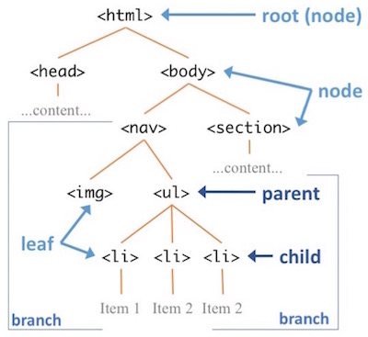
2. Real DOM & Virtual DOM
Real DOM is the actual tree-like structure of a web page, which can be manipulated directly to change the layout or content of the page.
Virtual DOM is a lightweight in-memory representation of the actual DOM.
It’s used to optimize the performance of updates to the user interface.

Slide 12
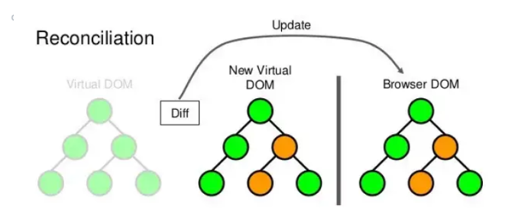
3. Reconciliation
Reconciliation is the process that React uses to determine the minimal set of changes to be made to the actual DOM.
It compares the current virtual DOM tree with a new virtual DOM tree, and then applies the minimal set of changes to the actual DOM.

Slide 13
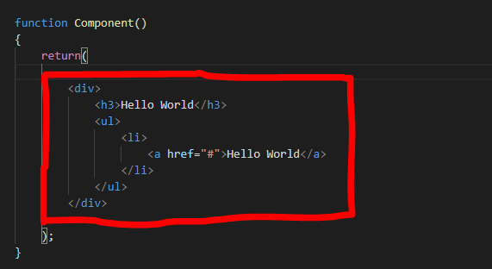
4. JSX
JSX is javascript syntax extension.
JSX is a syntax extension for JavaScript that allows developers to write HTML-like elements in their JavaScript code.
Browsers cannot read JSX files directly. They must be transpiled, or converted, to JavaScript before they can be interpreted by the browser.
It is commonly used ni React to describe the structure and content of a component's user interface.

Slide 14
5. React States
State in React is an object that holds data that can change.
It is used to store and update the component's data.
It is managed by a component.
We will use useState() hook for managing state of component.

Slide 15

6. React Hooks
React Hooks were first introduced in React 16.8 in 2019.
Now React hooks is the industry standard.
React Hooks are functions that allow you to useState and other React features in functional components.
The useState hook allows you to a d d state to a functional component.

Slide 16
What Next ?????

Slide 18
Project setup & getting started with React

Slide 19
How to start a React Project
Download Node from - https://nodejs.org/en/download
npx create-react-app my-app
cd my-app
npm start

Slide 20
Understanding useState with Examples

Slide 21
Project 1 - Building Todo List App

Slide 22
Project 2 - Building Airline Landing Page

Slide 23


Slide 24
Thank You
Code Link - https://github.com/harshit-8080

